Slide 1

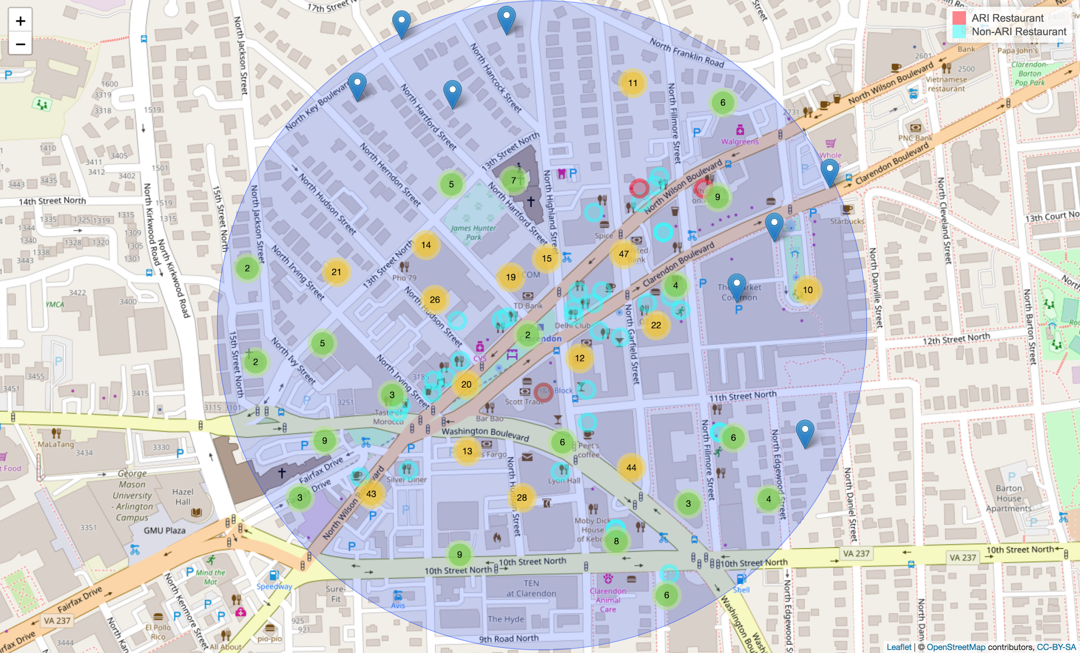
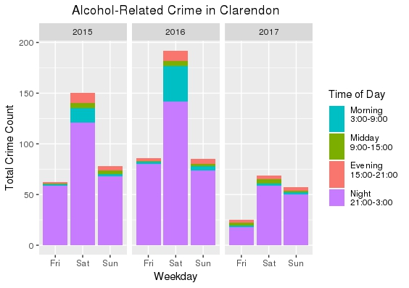
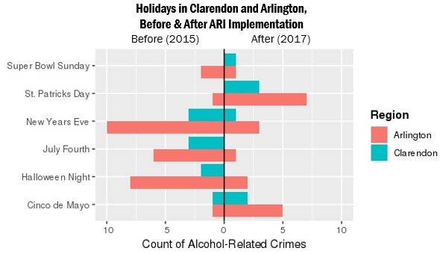

Sponsor: Jim Mastoras, Arlington County Police Department
Evaluating the Impact of the Arlington Restaurant Initiative on Alcohol-Related Crimes in Clarendon
Alexa Nosal (VT), Kelsey McMahon (VT), Megan Grondine (VT), Hannah Brinkley (VT) , and Bayoán Santiago Calderón (CGU)
SDAL: Gizem Korkmaz and Aaron Schroeder
Sponsors: Jim Mastoras, Arlington County Police Department; and the Virginia Tech Center for Peace Studies and Violence Prevention (CPSVP)
Project Overview
Background: Arlington County features some of the most unique restaurants and nightlife destinations in the Washington D.C. metro region. Areas such as Clarendon, however, with a large number of restaurants have become a difficult issue for police to manage due to alcohol-related crimes such as malicious wounding, sexual assault, public intoxication, assault on police, DUI, disorderly conduct, and rape.
Arlington County Police Department (ACPD) launched the Arlington Restaurant Initiative (ARI) that focuses on best practices for restaurants and nightlife to reduce the risk of alcohol-related disorder. The initiative grew out of the Clarendon Detail, the creation of a team of patrol officers using overtime to control pedestrian and road traffic, and to ensure that intoxicated patrons are protected from harm.
Clarendon Detail Contacts
 | 2016 | 2017
Assaults/Disputes | 451 | 570
Drunk in Public (DIP) / Sent on Way (SOW) | 1,308 | 1,400
DIP Pedestrians |  | 5,375
Uber/Taxi Obstructions | 4,080 | 8,465
Bannings | 25 | 31
Reports | 190 | 123
Field Observation Report (FOR) | 8 | 47
Contacts | 8,922 | 15,898
Arrests |  | 98
Virginia Uniform Summons (VUS) |  | 39
Officers working the Clarendon Detail collect activity logs (summarized on the left) to capture information about all contacts between police and citizens on the busiest nights regardless of whether or not a formal incident report was written.
The logs revealed that, despite the impact of excessive alcohol consumption on the crimes listed above, only about 10% of police contacts with the public result in an arrest.
Summary of Clarendon Detail Resources
 | 2016 | 2017
Weekend Days | 117 | 109
Officers | 1,153 | 1,254
Avg. Officers per Day | 9.9 | 11.5
Clarendon has over 40 restaurants (pinned in blue circles) with ABC (Alcohol and Beverage Control) licenses and an average of 5,500 patrons per weekend night. Each year, approximately 580,00 patrons visit Clarendon between 21:00 and 03:00, especially during holidays and special ”drinking” events. Alcohol-related crime counts in Clarendon on Friday, Saturday, and Sunday between 21:00 and 03:00 for 2015-2017 are given in yellow and green circles.
Objective: Evaluate effectiveness (social and economic impact) of ARI in Clarendon to help ACPD sustain and support the program.
Exploratory Data Analysis
Crime incident data were obtained from the Arlington County Police Incident Log dataset using the API.
Spatial and temporal filters were applied to obtain data for the Clarendon area (about a 0.4 km radius from the Clarendon metro station) from 21:00 to 03:00, the time frame in which the majority of alcohol-related crimes occur.
Focused on five different categories of crime: aggravated assault, disorderly conduct, drunk in public, DUI, rape/sexual assault. Table on the right summarizes crime rates for the time periods and area of study.
Conducted exploratory analysis of spatial and temporal variation, and the differences between trends in Clarendon and Arlington.
Year | Aggravated Assault | Disorderly Conduct | Drunk in Public | DUI | Rape / Sexual Assault | Underage Drinking / Fake ID
2015 | 92 | 22 | 176 | 40 | 2 | 1
2016 | 74 | 41 | 188 | 51 | 7 | 2
2017 | 35 | 6 | 162 | 27 | 9 | 0
ARI works to decrease alcohol-related crimes between the hours of 21:00 and 03:00 (night), when observed nightlife is most active.
The figure on the left includes only the alcohol-related crime types (shown in table above) that occurred within the Clarendon area.
The intervals in this graph depict the importance of the continuation of this program, as there is a sharp decrease in alcohol-related crimes since the program strategies were implemented in 2016.
The goal is to show the effect of ARI on the rate of crime in Arlington during special “drinking” events and holidays.
We chose the holidays that are normally associated with increased rates of alcohol consumption.
The graph includes alcohol-related crimes committed between the hours of 21:00 to 03:00 (night) for Clarendon and Arlington (incl. Clarendon) before and after the ARI strategies were implemented in 2016.
This plot shows a general decrease in crime in both regions on holidays.
Cost of Crimes
Next Steps
 | Miller, Chonen, Wiersema (1996) | Miller et al. (1996) | Aos et al. (2001) | Cohen et al. (2004) | McCollister (2010) | Other Ticket Fees (before other legal fees)
Aggravated assault | $14,673 | $24,493 | $120,514 | $96,547 | $122,198
Drunk in Public, Disorderly Conduct & Public Urination |  |  |  |  |  | $250
DUI | $28,097 |  |  |  |  | $300
Rape/sexual assault | $135,806 | $142,065 | $422,180 | $326,880 | $274,925
Underage Drinking / Fake ID |  |  |  |  |  | $500
Not only is the ARI important in improving safety and quality of life in Arlington, but it also helps save taxpayer money.
The table on the left shows the economic cost of crimes from a variety of studies that use different methods of cost estimation. Some of the methods include tangible costs, intangible costs, or both.
Tangible costs include costs such as medical expenses, lost wages/productivity, and the cost to repair property.
Intangible costs are the cost of pain and lost quality of life.
The Miller (1996) studies and ticket fees do only tangible costs while the other studies include both tangible and intangible.
This study illustrates an exploratory analysis of the effect of ARI on alcohol-related crimes before and after it was implemented in 2016.
The next step is to develop methods to estimate the reduction in crime that is solely due to the ARI since other factors also have a role in the reduction of crimes.
The crime cost estimates will then be used to calculate the cost savings as a result of the ARI program.
The interactive version of the plots and the model results will be illustrated on our dashboard during the DSPG 2018 symposium.
References/Acknowledgements
[1] Miller, Cohen, Wiersema. Victim Cost and Consequences: A New Look, National Institute of Justice, 1996.
Heaton. Hidden in Plain Sight: What Cost-of-Crime Research Can Tell Us About Investing in Police, RAND Corporation, 2010.
[2] McCollister, French, Fang. The Cost of Crime to Society: New Crime-Specific Estimates for Policy and Program Evaluation, Drug and Alcohol Dependence, 2010.
[3] Maurer et al. Experts Report Challenges Estimating Costs and Suggest Improvements to Better Inform Policy Decisions, GAO highlights, 2017.
[4] Arlington County. 2018. Police Incident Log. http://bit.ly/21nPzoE.
Special thanks to Dr. Wenwen Zhang and her students at VT Urban Affairs and Planning.
Note: all unit costs expressed in 2016 dollars. Unit cost values were inflated using the Bureau of Labor Statistics inflation calculator based on the consumer price index (CPI). U.S. Department of Labor (2018), http://www.bls.gov/data/inflation_calculator.htm.
Stay Connected:
facebook.com/biocomplexity
twitter.com/biocomplexityvt
youtube.com/c/biocomplexity
google.com/+biocomplexity
Notes:
GENERAL RULES TO FOLLOW:
Stay in Google Slides to work on your poster because it:
provides a template with all the approved branding including colors, fonts, and logo placement/usage;
allows you to collaborate with others;
helps you to communicate with your fellow researchers, lab./dept., and creative services;
Editing this file:

